Slide 1
The Data Link Layer
Chapter 3
3.4 - 3.5

Slide 2
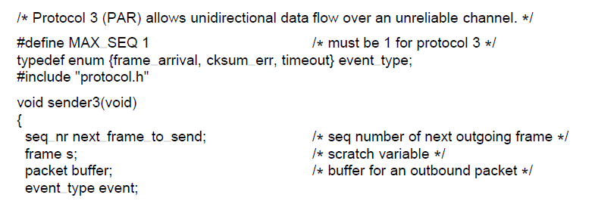
Sliding Window Protocols (1)
. . .
A positive acknowledgement with retransmission protocol.
Computer Networks, Fifth Edition by Andrew Tanenbaum and David Wetherall, © Pearson Education-Prentice Hall, 2011

Slide 3
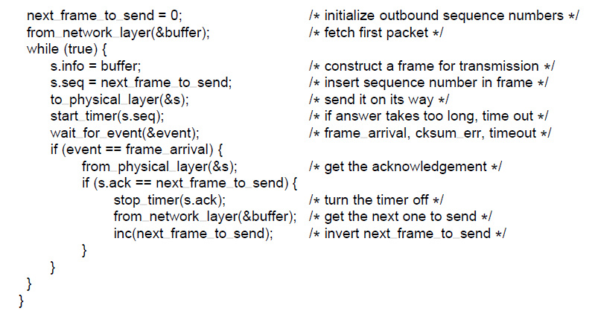
Sliding Window Protocols (2)
. . .
A positive acknowledgement with retransmission protocol.
Computer Networks, Fifth Edition by Andrew Tanenbaum and David Wetherall, © Pearson Education-Prentice Hall, 2011

Slide 4
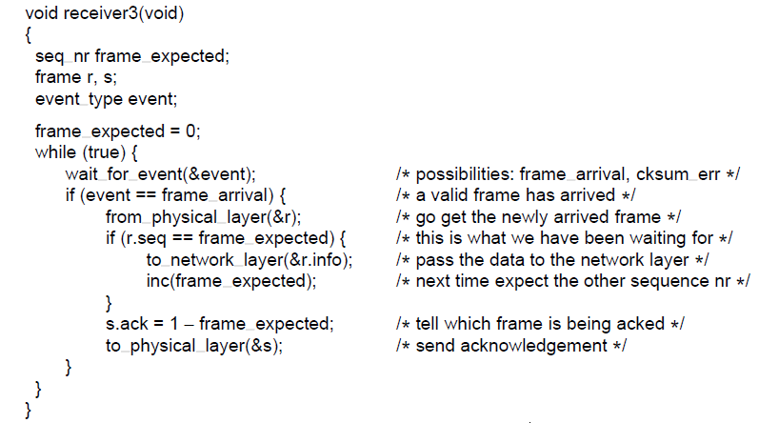
Sliding Window Protocols (3)
A positive acknowledgement with retransmission protocol.
Computer Networks, Fifth Edition by Andrew Tanenbaum and David Wetherall, © Pearson Education-Prentice Hall, 2011

Slide 5
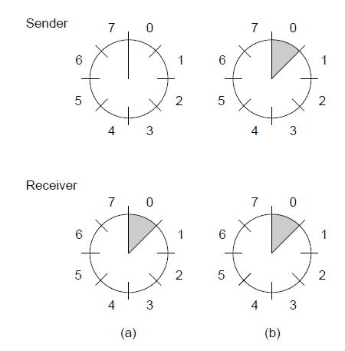
Sliding Window Protocols (4)
A sliding window of size 1, with a 3-bit sequence number.
(a) Initially. (b) After the first frame has been sent.
Computer Networks, Fifth Edition by Andrew Tanenbaum and David Wetherall, © Pearson Education-Prentice Hall, 2011

Slide 6
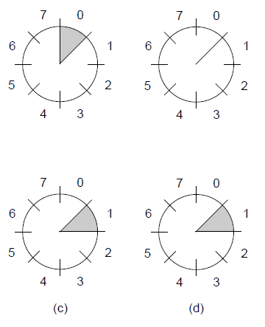


Sliding Window Protocols (5)
A sliding window of size 1, with a 3-bit sequence number
(c) After the first frame has been received. (d) After the first acknowledgement has been received.
Computer Networks, Fifth Edition by Andrew Tanenbaum and David Wetherall, © Pearson Education-Prentice Hall, 2011

Slide 7
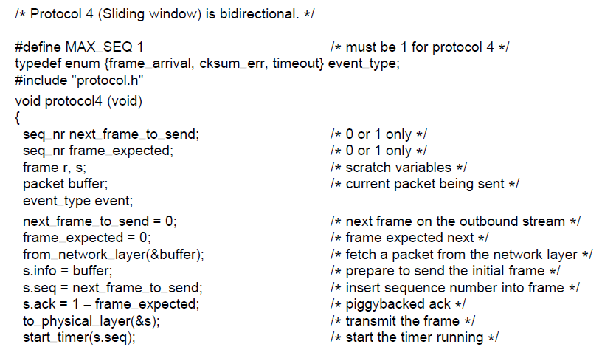
One-Bit Sliding Window Protocol (1)
. . .
A 1-bit sliding window protocol.
Computer Networks, Fifth Edition by Andrew Tanenbaum and David Wetherall, © Pearson Education-Prentice Hall, 2011

Slide 8
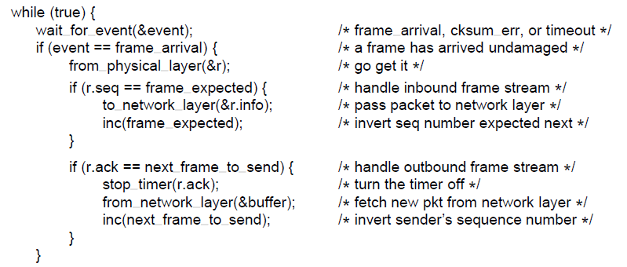
One-Bit Sliding Window Protocol (2)
. . .
A 1-bit sliding window protocol.
Computer Networks, Fifth Edition by Andrew Tanenbaum and David Wetherall, © Pearson Education-Prentice Hall, 2011

Slide 9
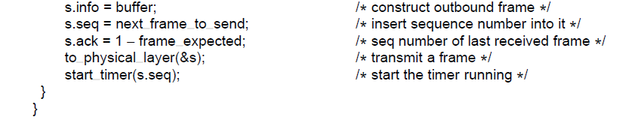
One-Bit Sliding Window Protocol (3)
A 1-bit sliding window protocol.
Computer Networks, Fifth Edition by Andrew Tanenbaum and David Wetherall, © Pearson Education-Prentice Hall, 2011

Slide 10
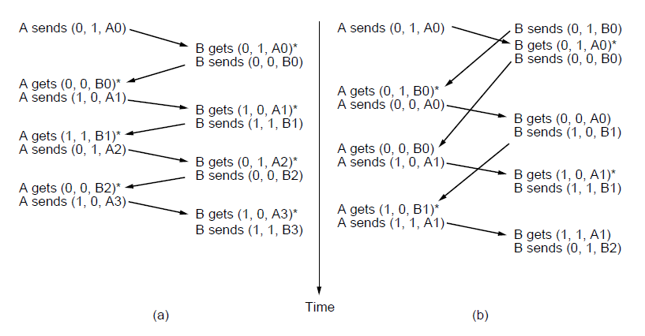
One-Bit Sliding Window Protocol (4)
Two scenarios for protocol 4. (a) Normal case. (b) Abnormal
case. The notation is (seq, ack, packet number). An asterisk indicates where a network layer accepts a packet
Computer Networks, Fifth Edition by Andrew Tanenbaum and David Wetherall, © Pearson Education-Prentice Hall, 2011

Slide 11
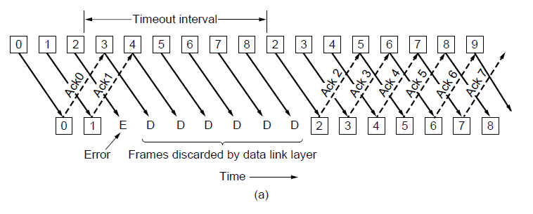
Protocol Using Go-Back-N (1)
Pipelining and error recovery. Effect of an error when
(a) receiver’s window size is 1
Computer Networks, Fifth Edition by Andrew Tanenbaum and David Wetherall, © Pearson Education-Prentice Hall, 2011

Slide 12
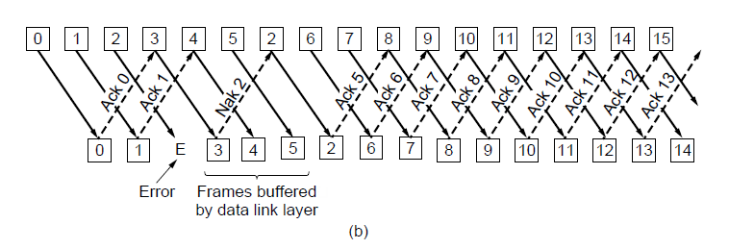
Protocol Using Go-Back-N (2)
Pipelining and error recovery. Effect of an error when
(b) receiver’s window size is large.
Computer Networks, Fifth Edition by Andrew Tanenbaum and David Wetherall, © Pearson Education-Prentice Hall, 2011

Slide 13
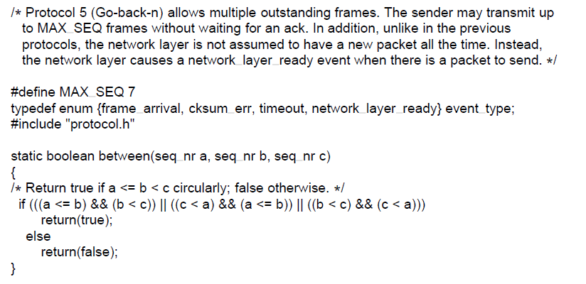
Protocol Using Go-Back-N (3)
. . .
A sliding window protocol using go-back-n.
Computer Networks, Fifth Edition by Andrew Tanenbaum and David Wetherall, © Pearson Education-Prentice Hall, 2011

Slide 14
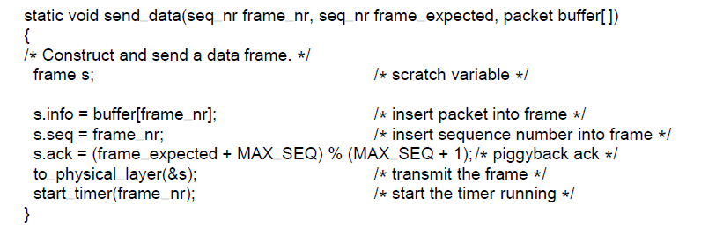
Protocol Using Go-Back-N (4)
. . .
A sliding window protocol using go-back-n.
Computer Networks, Fifth Edition by Andrew Tanenbaum and David Wetherall, © Pearson Education-Prentice Hall, 2011

Slide 15
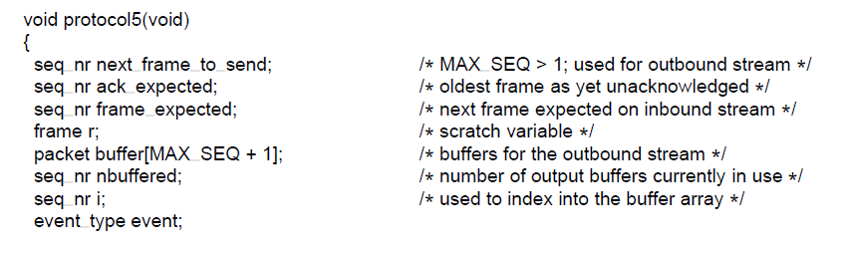
Protocol Using Go-Back-N (5)
. . .
A sliding window protocol using go-back-n.
Computer Networks, Fifth Edition by Andrew Tanenbaum and David Wetherall, © Pearson Education-Prentice Hall, 2011

Slide 16
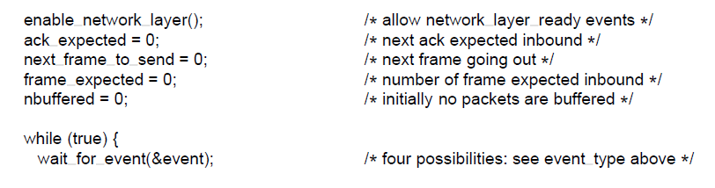
Protocol Using Go-Back-N (6)
. . .
A sliding window protocol using go-back-n.
Computer Networks, Fifth Edition by Andrew Tanenbaum and David Wetherall, © Pearson Education-Prentice Hall, 2011

Slide 17
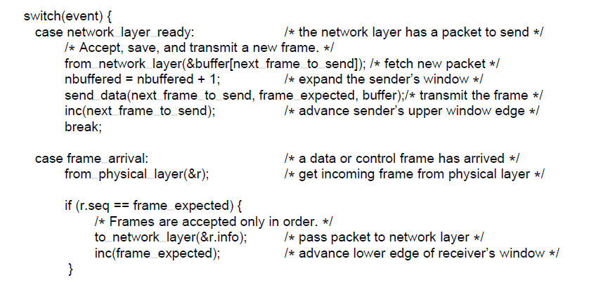
Protocol Using Go-Back-N (7)
. . .
A sliding window protocol using go-back-n.
Computer Networks, Fifth Edition by Andrew Tanenbaum and David Wetherall, © Pearson Education-Prentice Hall, 2011

Slide 18
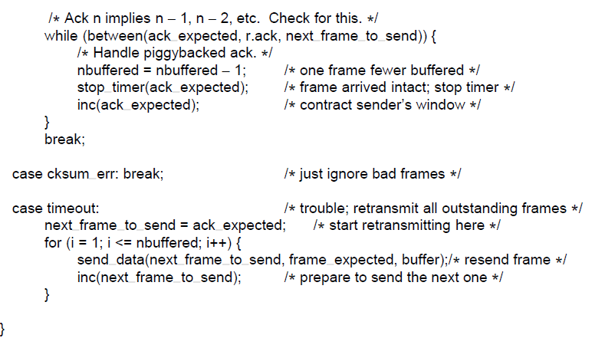
Protocol Using Go-Back-N (8)
. . .
A sliding window protocol using go-back-n.
Computer Networks, Fifth Edition by Andrew Tanenbaum and David Wetherall, © Pearson Education-Prentice Hall, 2011

Slide 19
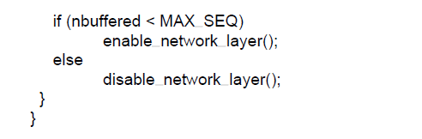
Protocol Using Go-Back-N (9)
A sliding window protocol using go-back-n.
Computer Networks, Fifth Edition by Andrew Tanenbaum and David Wetherall, © Pearson Education-Prentice Hall, 2011

Slide 20
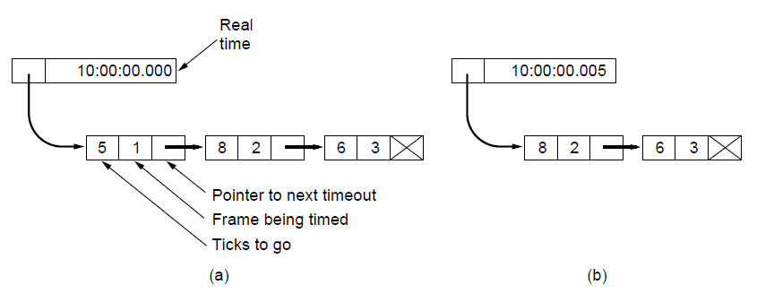
Protocol Using Go-Back-N (10)
Simulation of multiple timers in software. (a) The queued
timeouts (b) The situation after the first timeout has expired.
Computer Networks, Fifth Edition by Andrew Tanenbaum and David Wetherall, © Pearson Education-Prentice Hall, 2011

Slide 21
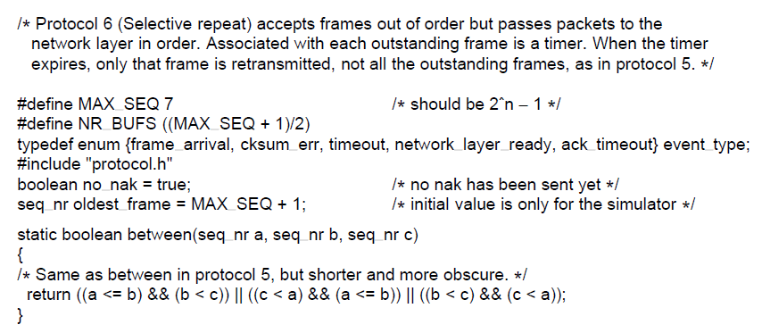
Protocol Using Selective Repeat (1)
. . .
A sliding window protocol using selective repeat.
Computer Networks, Fifth Edition by Andrew Tanenbaum and David Wetherall, © Pearson Education-Prentice Hall, 2011

Slide 22
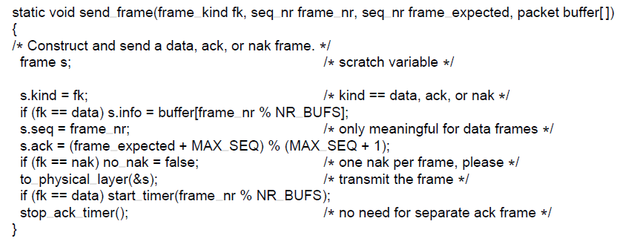
Protocol Using Selective Repeat (2)
. . .
A sliding window protocol using selective repeat.
Computer Networks, Fifth Edition by Andrew Tanenbaum and David Wetherall, © Pearson Education-Prentice Hall, 2011

Slide 23
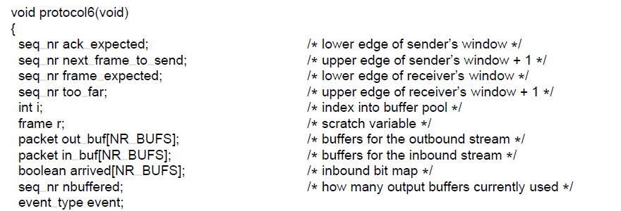
Protocol Using Selective Repeat (3)
. . .
A sliding window protocol using selective repeat.
Computer Networks, Fifth Edition by Andrew Tanenbaum and David Wetherall, © Pearson Education-Prentice Hall, 2011

Slide 24
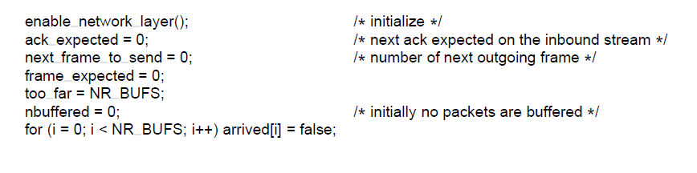
Protocol Using Selective Repeat (4)
. . .
A sliding window protocol using selective repeat.
Computer Networks, Fifth Edition by Andrew Tanenbaum and David Wetherall, © Pearson Education-Prentice Hall, 2011

Slide 25
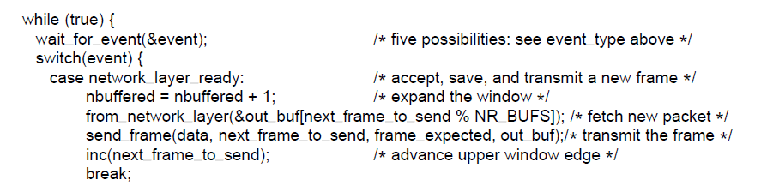
Protocol Using Selective Repeat (5)
. . .
A sliding window protocol using selective repeat.
Computer Networks, Fifth Edition by Andrew Tanenbaum and David Wetherall, © Pearson Education-Prentice Hall, 2011

Slide 26
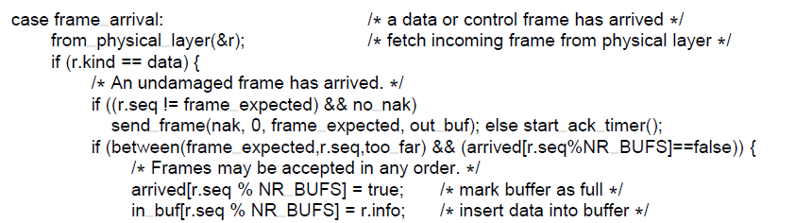
Protocol Using Selective Repeat (6)
. . .
A sliding window protocol using selective repeat.
Computer Networks, Fifth Edition by Andrew Tanenbaum and David Wetherall, © Pearson Education-Prentice Hall, 2011

Slide 27
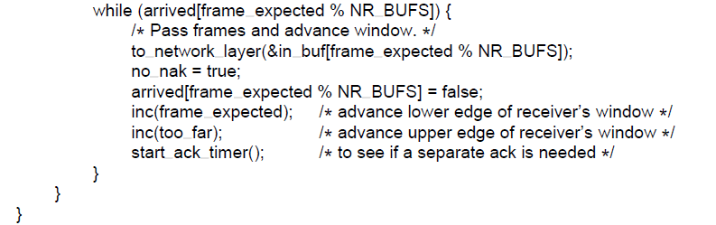
Protocol Using Selective Repeat (7)
. . .
A sliding window protocol using selective repeat.
Computer Networks, Fifth Edition by Andrew Tanenbaum and David Wetherall, © Pearson Education-Prentice Hall, 2011

Slide 28
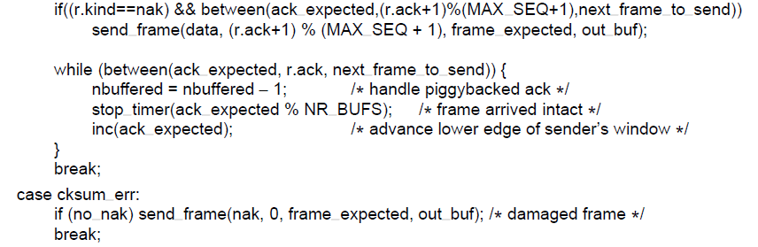
Protocol Using Selective Repeat (8)
. . .
A sliding window protocol using selective repeat.
Computer Networks, Fifth Edition by Andrew Tanenbaum and David Wetherall, © Pearson Education-Prentice Hall, 2011

Slide 29
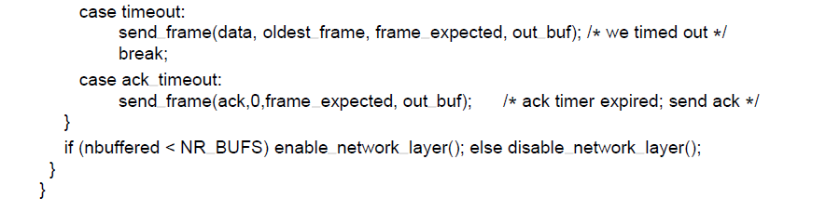
Protocol Using Selective Repeat (9)
A sliding window protocol using selective repeat.
Computer Networks, Fifth Edition by Andrew Tanenbaum and David Wetherall, © Pearson Education-Prentice Hall, 2011

Slide 30
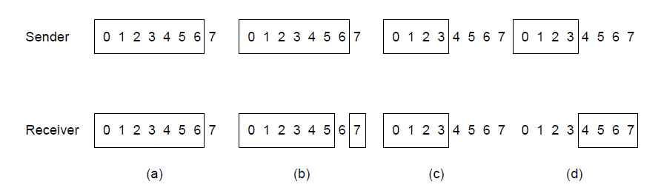
Protocol Using Selective Repeat (10)
Initial situation with a window of size7
After 7 frames sent and received but not acknowledged.
Initial situation with a window size of 4.
After 4 frames sent and received but not acknowledged.
Computer Networks, Fifth Edition by Andrew Tanenbaum and David Wetherall, © Pearson Education-Prentice Hall, 2011

Slide 31
Example Data Link Protocols
Packet over SONET
ADSL (Asymmetric Digital Subscriber Loop)
Computer Networks, Fifth Edition by Andrew Tanenbaum and David Wetherall, © Pearson Education-Prentice Hall, 2011

Slide 32
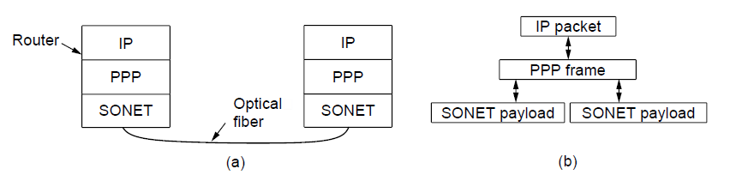
Packet over SONET (1)
Packet over SONET. (a) A protocol stack. (b) Frame relationships
Computer Networks, Fifth Edition by Andrew Tanenbaum and David Wetherall, © Pearson Education-Prentice Hall, 2011

Slide 33
Packet over SONET (2)
PPP Features
Separate packets, error detection
Link Control Protocol
Network Control Protocol
Computer Networks, Fifth Edition by Andrew Tanenbaum and David Wetherall, © Pearson Education-Prentice Hall, 2011

Slide 34
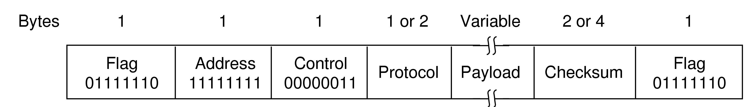
Packet over SONET (3)
The PPP full frame format for unnumbered mode operation
Computer Networks, Fifth Edition by Andrew Tanenbaum and David Wetherall, © Pearson Education-Prentice Hall, 2011

Slide 35
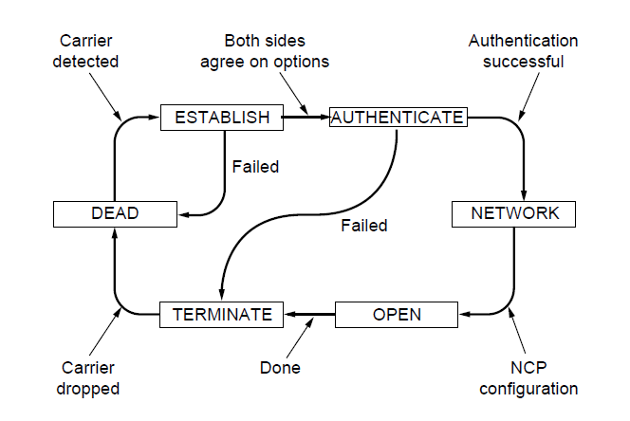
Packet over SONET (4)
State diagram for bringing a PPP link up and down
Computer Networks, Fifth Edition by Andrew Tanenbaum and David Wetherall, © Pearson Education-Prentice Hall, 2011

Slide 36
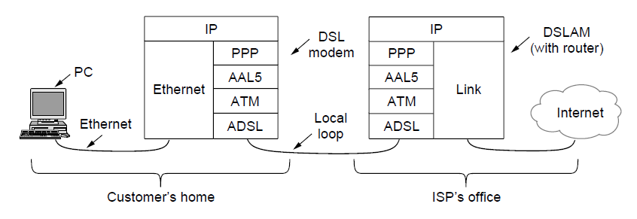
ADSL (Asymmetric Digital
Subscriber Loop) (1)
ADSL protocol stacks.
Computer Networks, Fifth Edition by Andrew Tanenbaum and David Wetherall, © Pearson Education-Prentice Hall, 2011

Slide 37
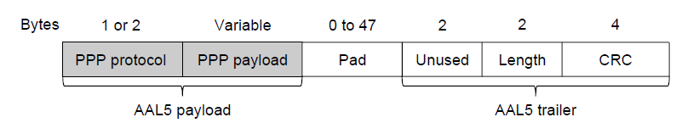
ADSL (Asymmetric Digital
Subscriber Loop) (1)
AAL5 frame carrying PPP data
Computer Networks, Fifth Edition by Andrew Tanenbaum and David Wetherall, © Pearson Education-Prentice Hall, 2011

Slide 38
End
Chapter 3
Computer Networks, Fifth Edition by Andrew Tanenbaum and David Wetherall, © Pearson Education-Prentice Hall, 2011

